Slide 1
Banana Map
Team
Banana🍌

Slide 2

Our team
Jake Van Meter
Jessica Tanumihardja
Shreya Goyal
Randy Ramli
Zhiwei Zhou
Chunyun Zhang

Slide 3
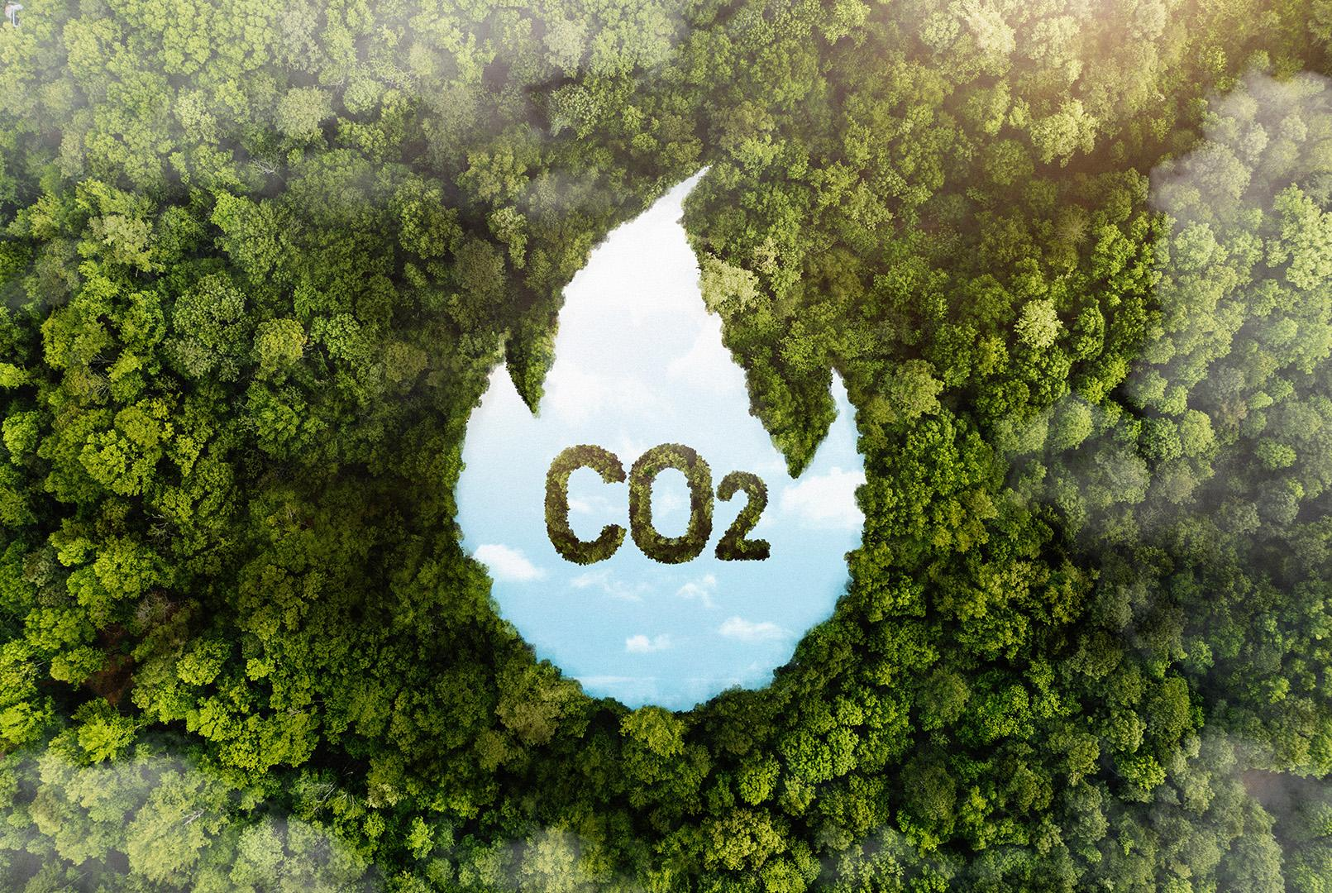
Transportation and Climate Change
Greenhouse gas (GHG) emissions from transportation account for about 27% of
total U.S. greenhouse gas emissions, making it the largest contributor of U.S. GHG emissions.
Between 1990 and 2020, GHG emissions in the transportation sector increased more in absolute terms than any other sector.
Reference: United States Environmental Protection Agency

Slide 4

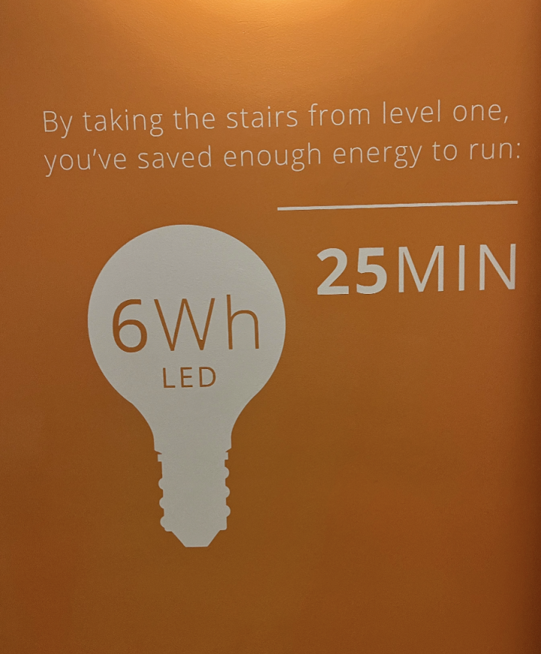
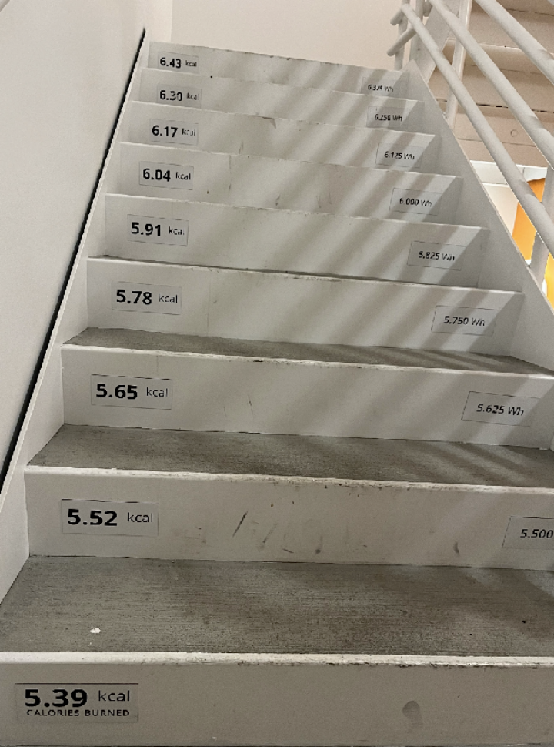
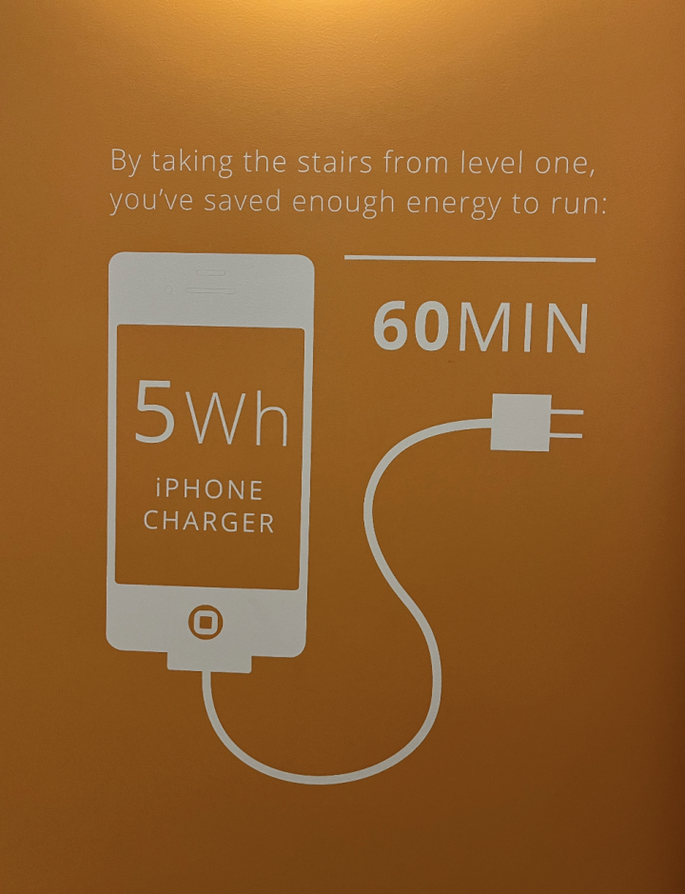
Inspirations

Slide 5
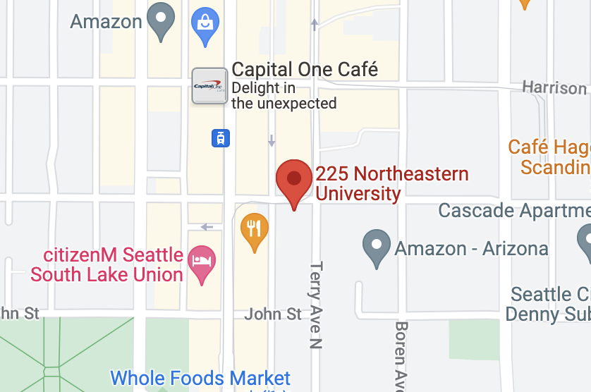
Emission-counting web app
📍 Compare carbon emissions of different routes of transportation.
📍 Count how much energy saved for using low-carbon emission transportations.
📍 Encourage users to transit in an environmental friendly way.

Slide 6
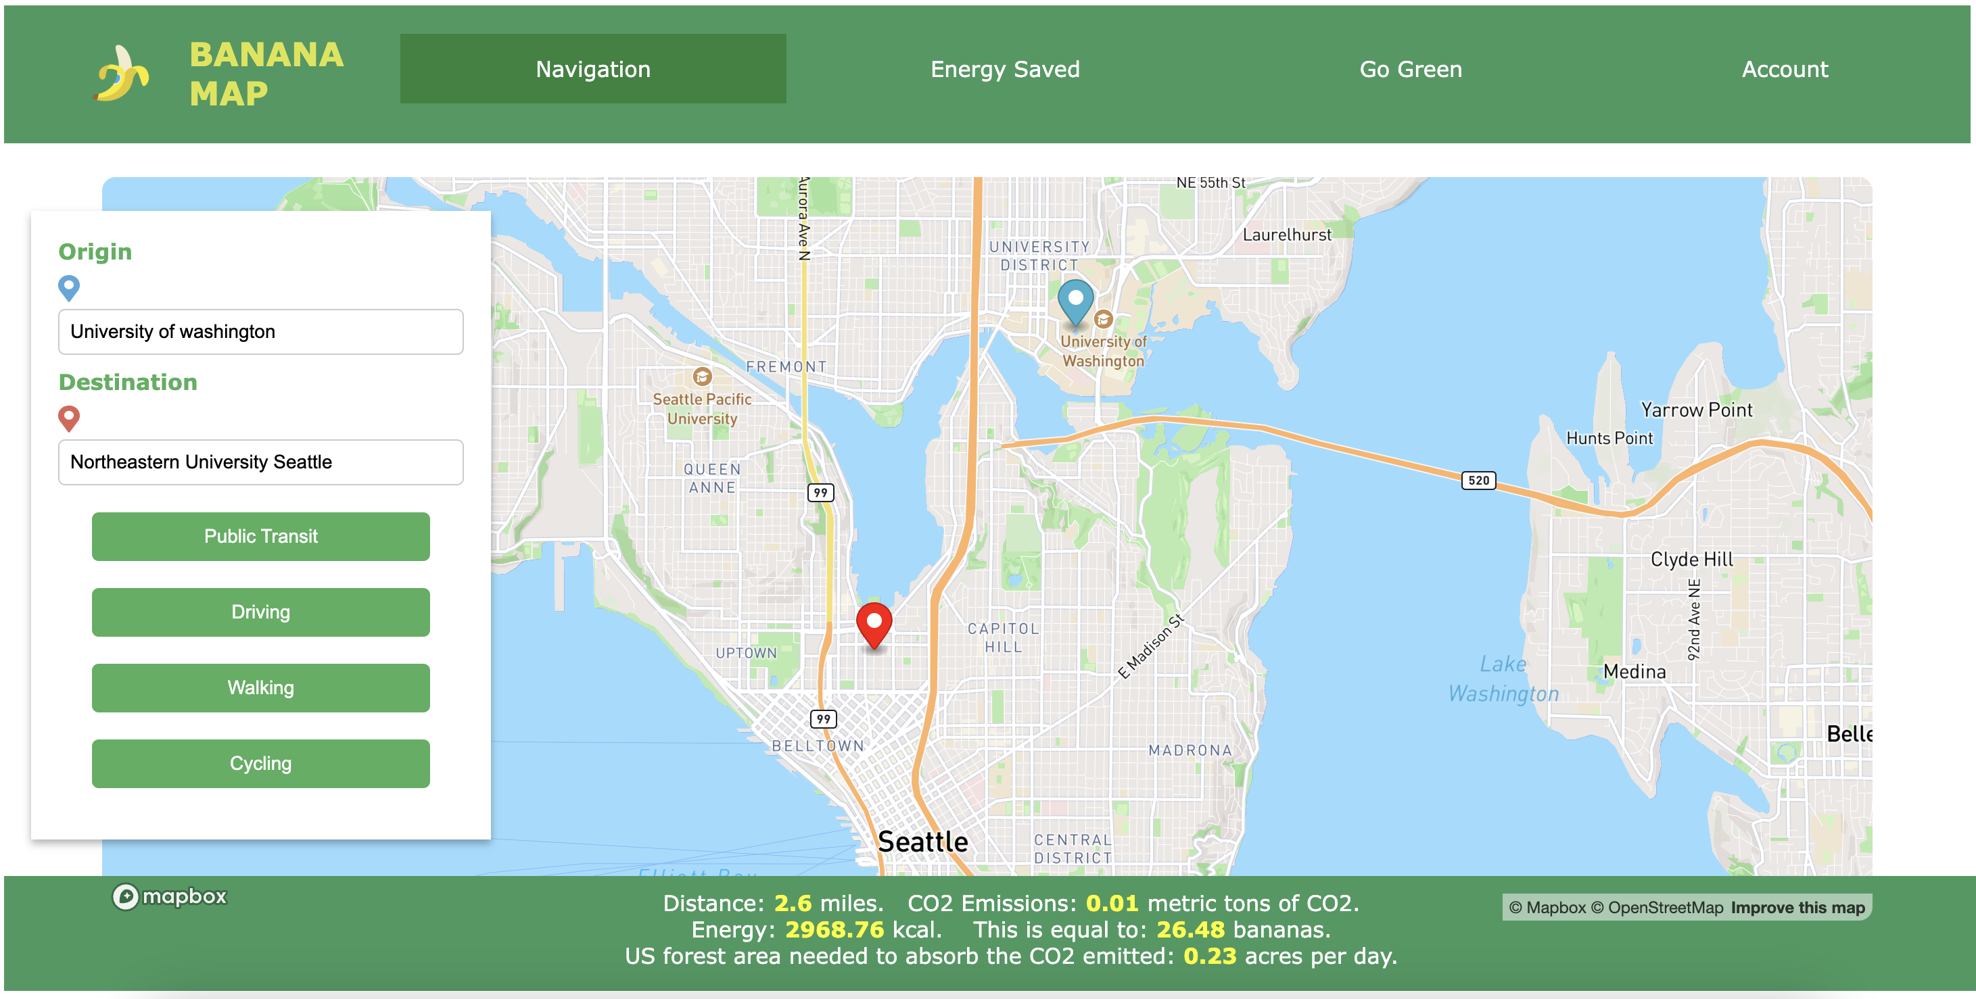
Web Application Interface

Slide 7
Features
Trip distance calculator
CO2 emissions tracking
Kcal energy expenditure tracking
Banana energy expenditure tracking

Slide 8
Carbon Emission Calculation
 | Carbon emission | Energy | Forest area to absorb C02
🚶Walk
🚗 Car
🚌 Bus
🚴Cycle
distance/ (walking mph)* walking energy
0
0
distance / (average car mpg) * (gal/kcal)
(metric ton CO2 sequestered /acre/day) / CO2 emission
distance * (car metric tons CO2/mile)​
distance / (average bus mpg) * (gal/kcal)
(metric ton CO2 sequestered /acre/day) / CO2 emission
distance * (bus metric tons CO2/mile)
Distance/ (cycling mph) * cycling energy
0
0
Equivalent banana = Energy / Calorie per banana

Slide 9
Data Resources
Kaggle:
CO2 Emissions by Vehicles: Vehicle Emissions Data
Redmi Fuel Band Record Tracker (Fitbit Dataset): Calorie Data
MapBox GL JS API: Mapping and location distances.
US EPA Greenhouse Gas Equivalence Calculator: Emissions to kcal converter
Public transportation passenger mpg
Calories burned per activity

Slide 10
Future Development
Develop a cross-platform application.
Reward users for saving energy from low-carbon transportations, such as using these energy to planting trees.
Involve more environmental friendly behaviors other than transportation, such as tracking household eletricity consumption and recycling.
Notes:
Cross platform
CO2 emissions tracking
Reward system for app usage and decreased emissions

Slide 11
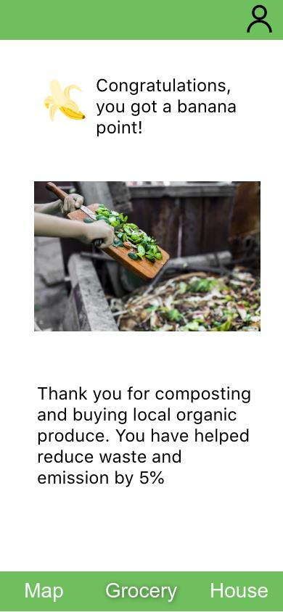
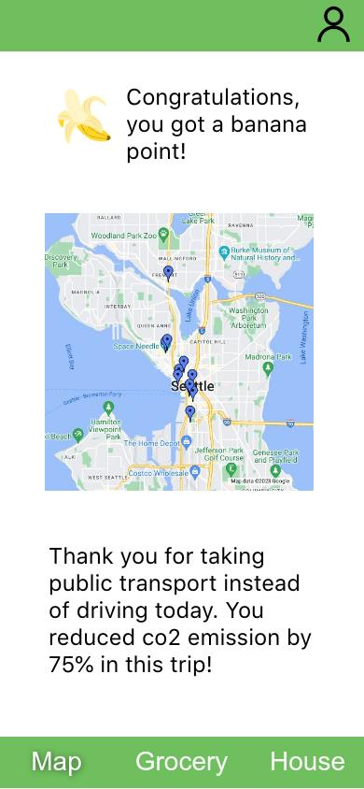
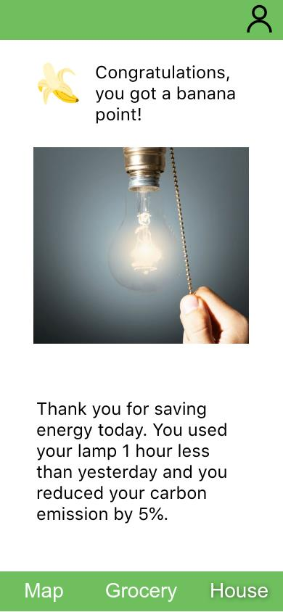
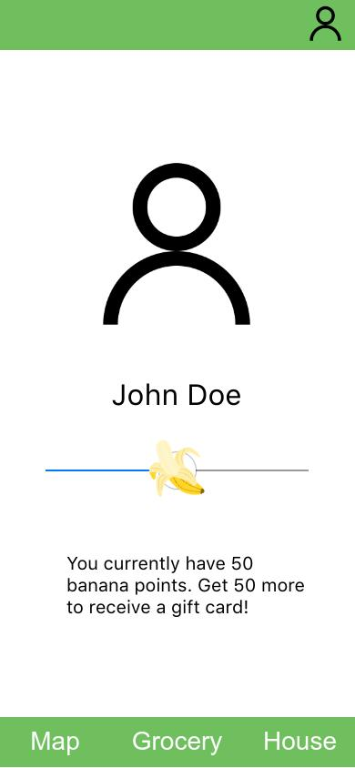
Mobile App Interface

Slide 12
Impacts
01
02
03
04
Sustainable
Lifestyle
Climate
Action
Responsible Comsumption
Partnership
for the Goals
Reference: United Nations, Sustainable Development Goals

Slide 13
Thanks!

